Slide 1
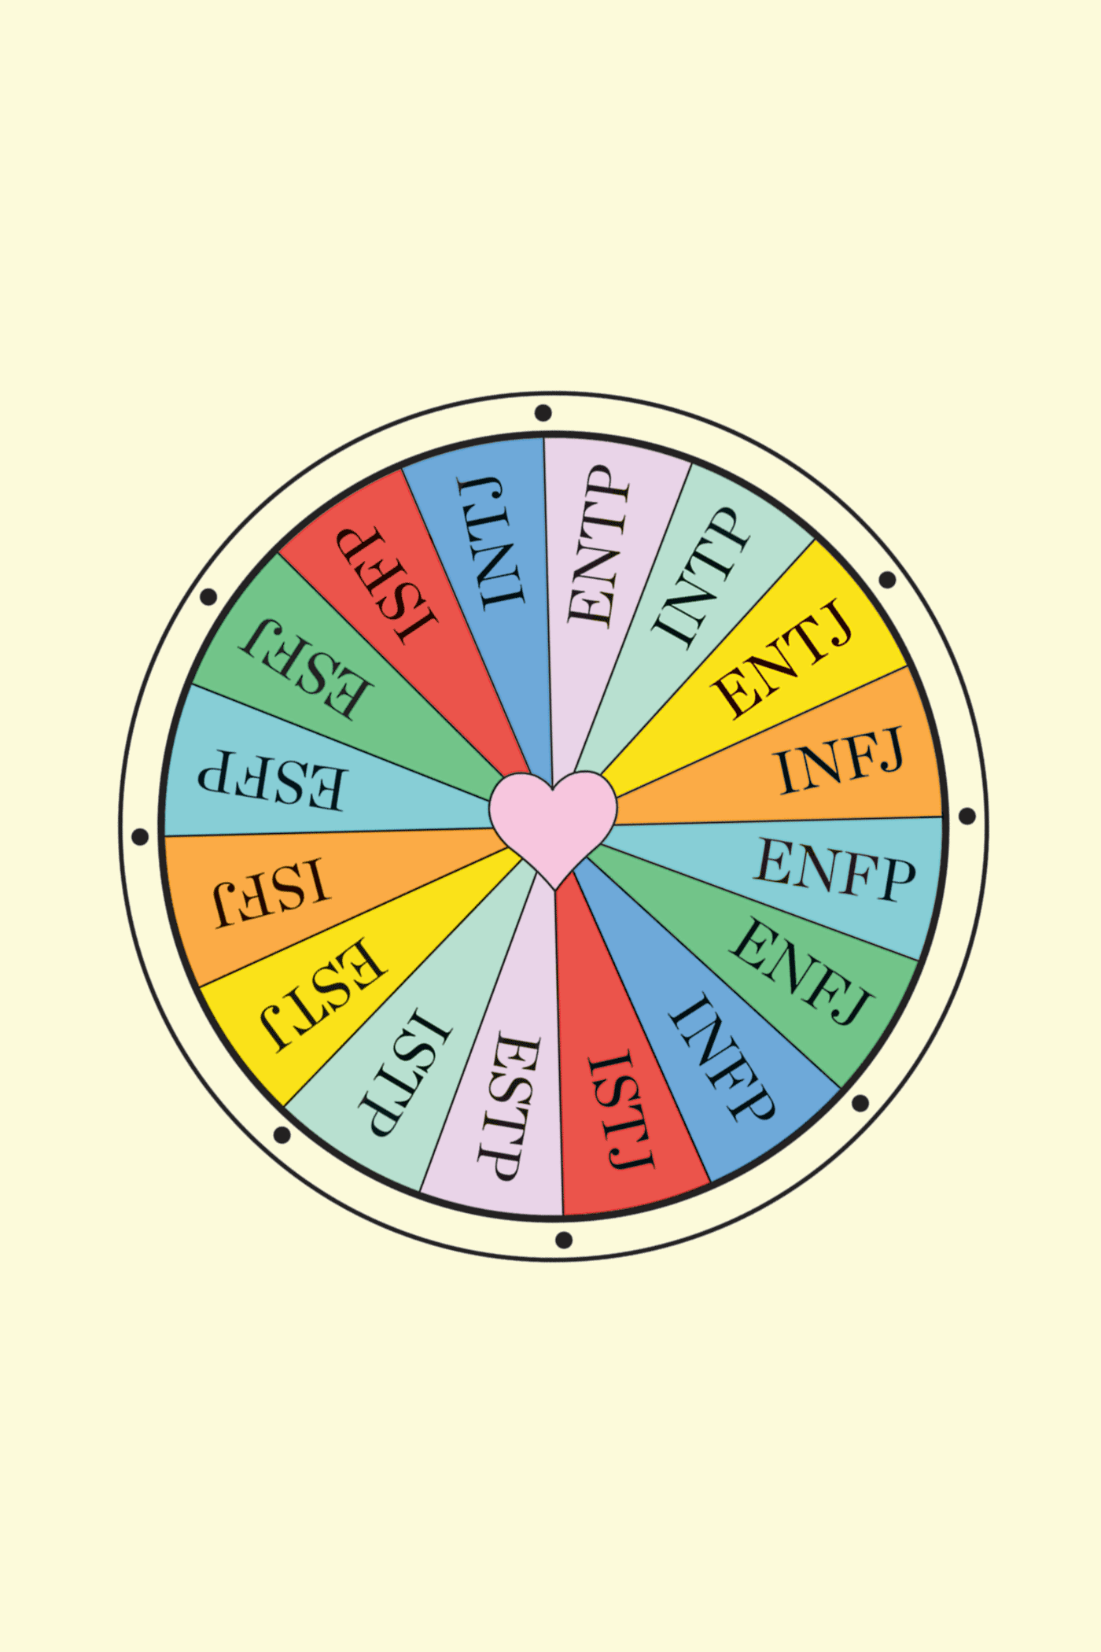
Personality Analysis
Myers-Briggs Type Indicator
Participants
Christopher Guilcapi
Eric Wyluda
Jose Monagas
Katiusca Quijada
Notes:
Chris

Slide 2
01
02
03
INTRODUCTION
Data ETL
Approach
ML
Approach
04
05
Dashboard
Analysis
Notes:
Chris

Slide 3


INTRODUCTION TO MYERS-BRIGGS PERSONALITY TYPE PROBLEM SET
Kaggle Twitter dataset of 200 users with the last 50 tweets from each account collected along with their Myers-Briggs Personality Type.
Purpose of Myers-Briggs Type Indicator is to make the theory of psychological types understandable and useful in people's lives. Seemingly random variation in behavior is actually quite consistent and there are differences in the ways individuals prefer to use their perception and judgment.
Notes:
Chris

Slide 4
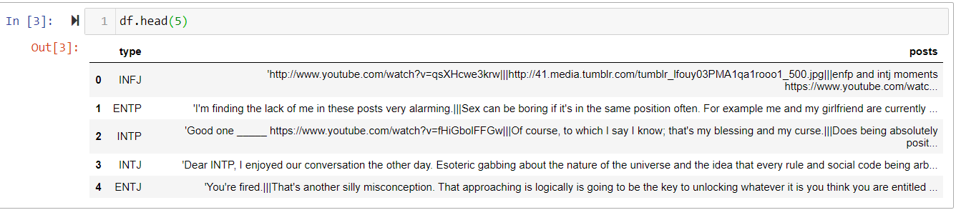
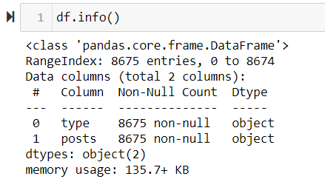
Examine provided data
Notes:
After loading in the provided csv data, we started by reading it into a dataframe to get a better look to see what we were working with…
The loaded data consisted of 8,675 entries which represented individual twitter accounts which had Myers-Briggs Personality Types indicated for each user along with 50 posts separated by three line breaks “|||” to distinguish the different posts.
The data required significant cleaning and preprocessing before it could be analyzed by the machine learning algorithm.
The data included hyperlink urls which required removal as well as many short words such as “a”, “to”, “the” which did not contribute to the accuracy of the machine learning study and therefore were removed in the preprocessing steps.

Slide 5
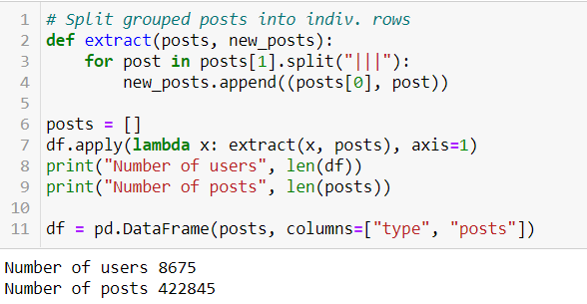
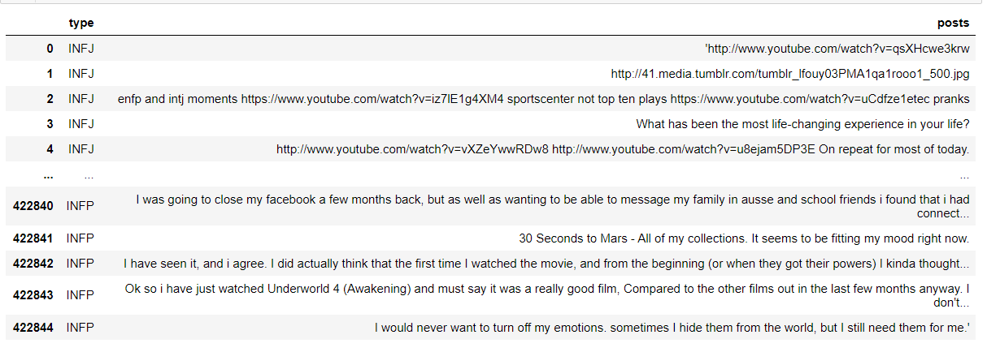
STEP 1: Split posts into rows
Cleaning up the Data Set with functions to have a clean data set for ML and the Dashboard
Notes:
Before we began cleaning the data, we first split the grouped posts into individual entries with the corresponding users.
This expanded our dataset from 8,675 entries to over 400 thousand entries.

Slide 6
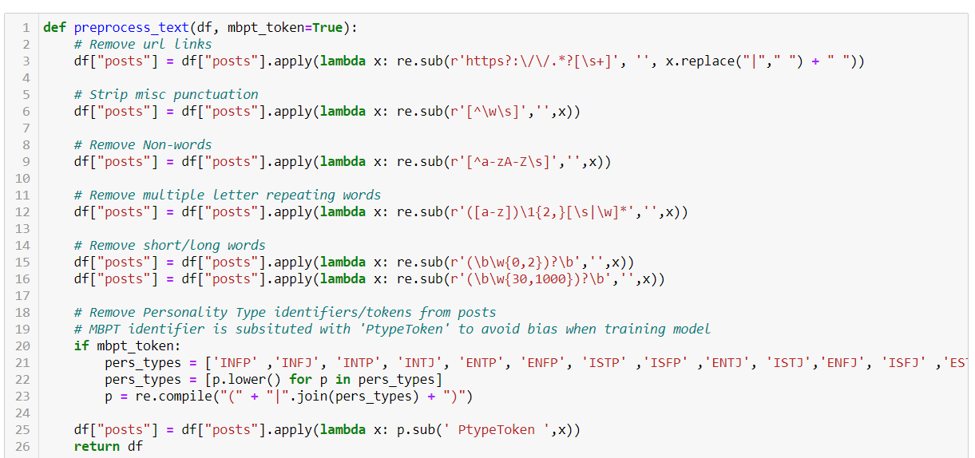
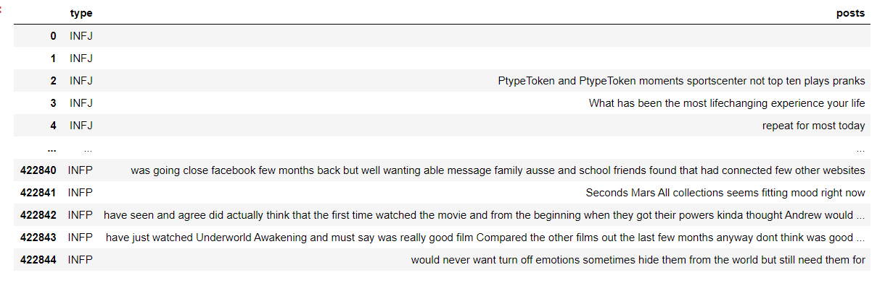
Data cleaning function
Cleaning up the Data Set with functions to have a clean data set for ML and the Dashboard
Notes:
We decided to create a function to perform the data cleaning.
The function consisted of multiple lambda functions which I found were the easiest and most straightforward to use in completing the individual cleaning steps.
We started with removing urls from posts

Slide 7
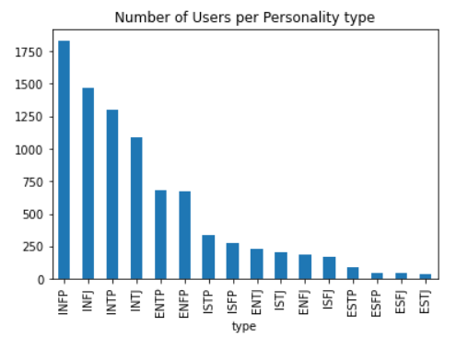
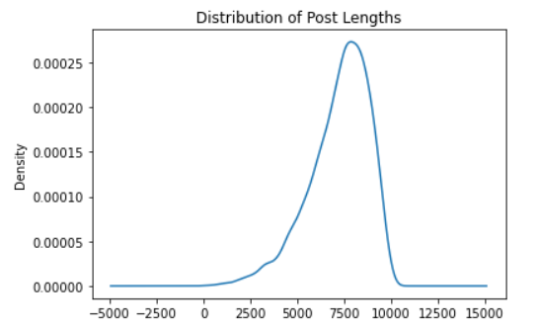
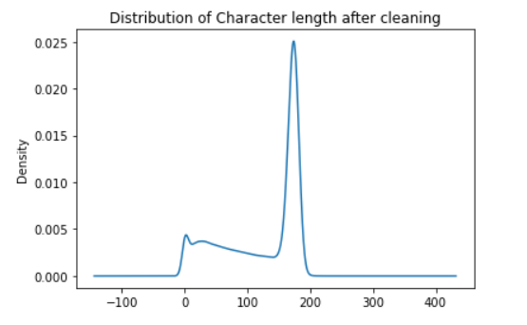
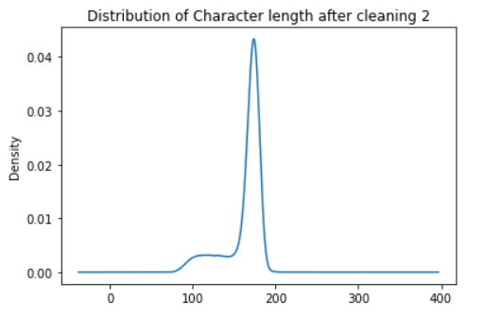
Distribution of data
Cleaning up the Data Set with functions to have a clean data set for ML and the Dashboard
Notes:
Eric

Slide 8
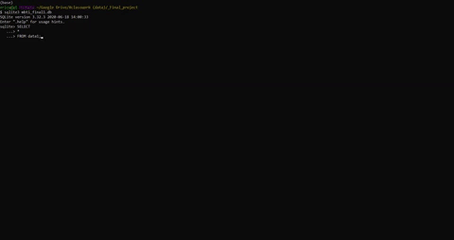
SQLite Database
Cleaning up the Data Set with functions to have a clean data set for ML and the Dashboard
Notes:
Eric

Slide 9
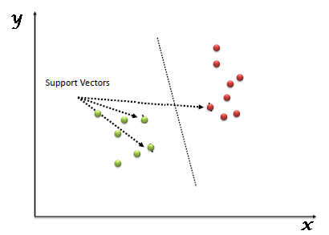
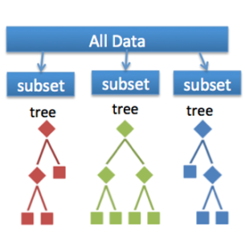
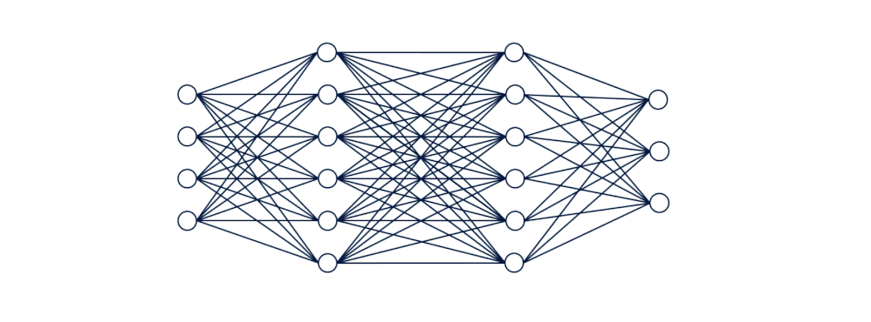
ML APPROACH
We explored three modeling approaches based on their suitability for NLP problems.
SVM: Supervised learning models with associated learning algorithms that analyze data for classification.
Random Forest: Large number of individual decision trees that operate together. Each tree has a class prediction and the one with most votes becomes our model’s prediction.
Neural Network: Multitude of simple processing nodes that are highly interconnected and send data through these network connections to estimate a target variable.
Notes:
For this project we used 3 ML models.

Slide 10
SVM
We applied SVM because of its reputation for success in text classification.
We split the data into training and testing sets
Then created a data pipeline with SGDClassifier.
Trained the model and made predictions.
Generated confusion matrix, classification report and heatmaps for better visualization

Slide 11
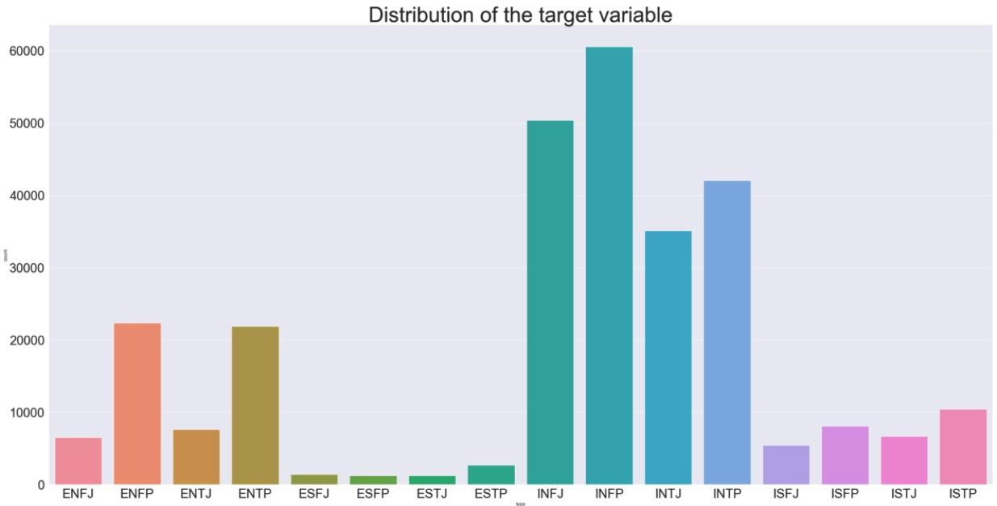
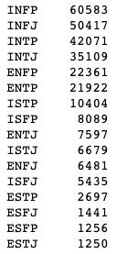

SVM aPPROACH
Distribution of the data
The data is unbalanced

Slide 12
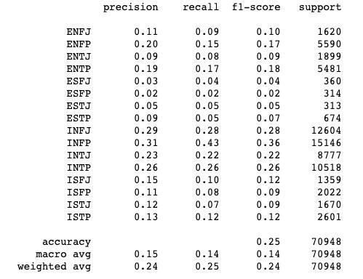
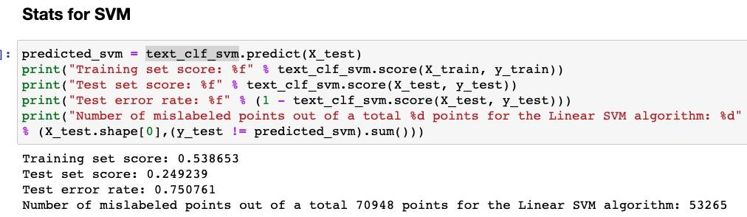
SVM RESULTS
Classification Report
Accuracy: 25%
Confusion Matrix: Best performance shown in subset ‘INFP’
Accuracy is higher for those metrics that are overrepresented
Notes:
Jose

Slide 13
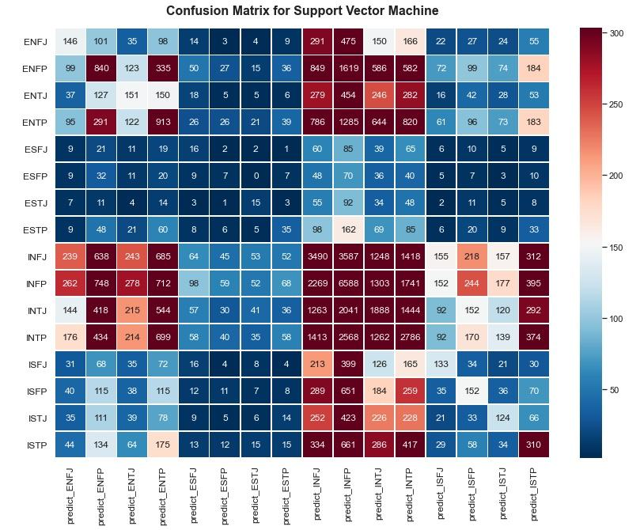
SVM Heatmap
It’s hard to understand this visualization so we normalized it.
Overrepresented

Slide 14
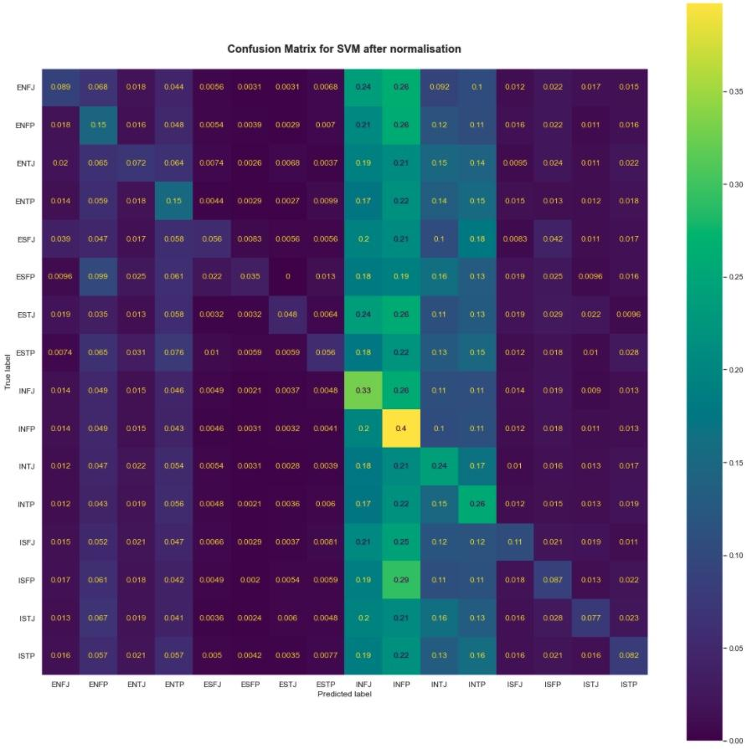
Svm heatmap normalized

Slide 15
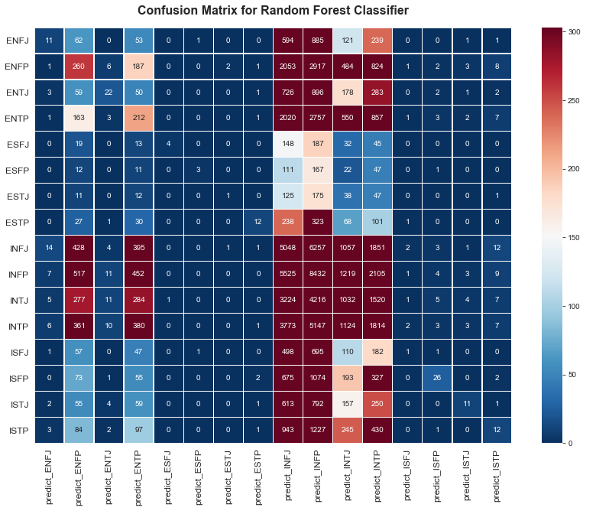
RANDOM FOREST RESULTS
Accuracy: 19.9%
Confusion Matrix: Best performance shown in subset ‘IN’ and ‘EN’ personalities
Conclusion: Slightly lower accuracy than baseline so not suited to predicting classes outside of the ones with the highest frequency.
Notes:
Katiusca

Slide 16
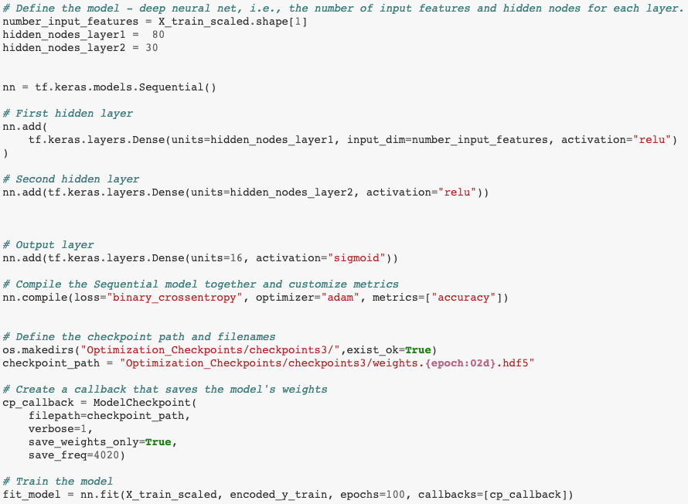
NEURAL NETWORK RESULTS
Accuracy: 27%
Loss: 18.9%
Conclusion: Best accuracy than baseline model at 21%.
Notes:
Katiusca

Slide 17





DASHBOARD CONNECTION
Notes:
Chris

Slide 18
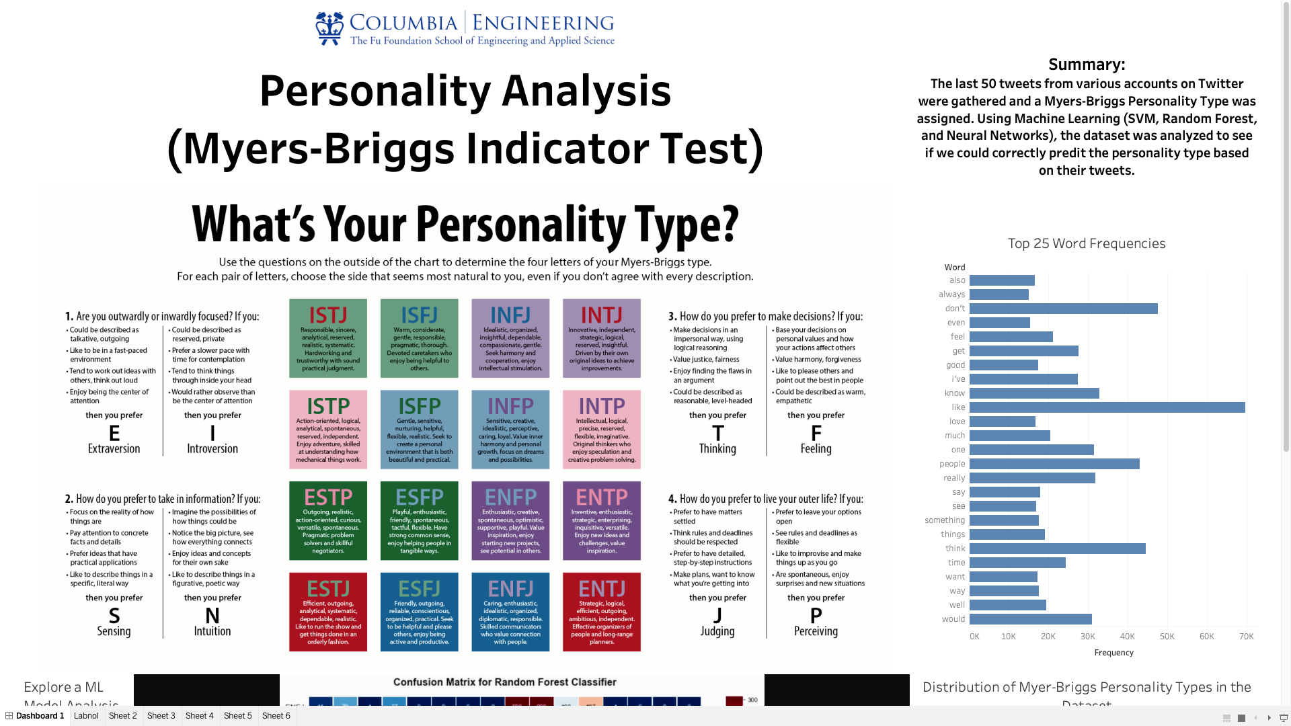
DASHBOARD (Click Here)
Notes:
Chris

Slide 19
ANALYSIS
Larger (n) increases accuracy, our dataset included tweets from 8,675 users with over 50% belonging to 3 personality types.
Sentiment analysis would be explored in further analysis, by which certain words would be positively or negatively weighted based on their correlation to certain personality types.
The models misclassify a lot of data by predicting the personality types that are overrepresented. One way to improve this model is by regularizing and penalizing the data points so that the dataset is not so skewed.
Notes:
Jose (Analysis), Eric (Recommendations)

Slide 20
Thanks!
Does anyone have
any questions?
CREDITS: This presentation template was created by Slidesgo, including icons by Flaticon, infographics & images by Freepik and illustrations by Stories
Notes:
Eric

